Slide 1

MAT205: Abstract Algebra II
12. Isomorphism Extension
Ma, Jia-Jun

Slide 2
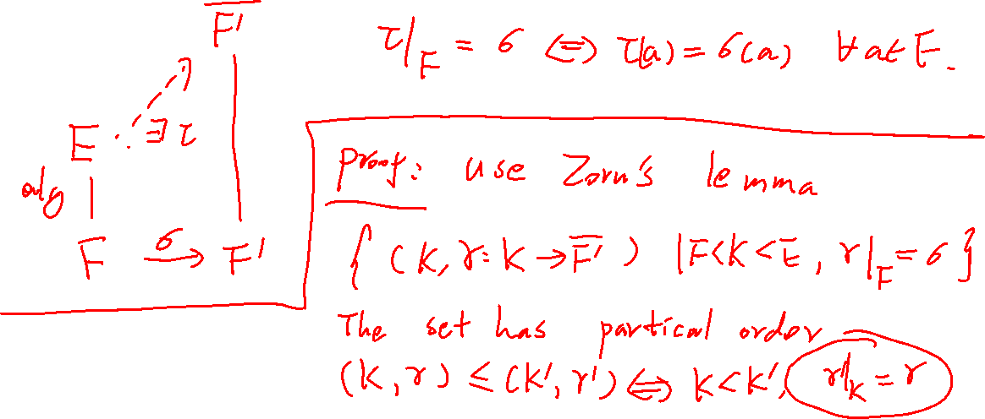

Slide 3
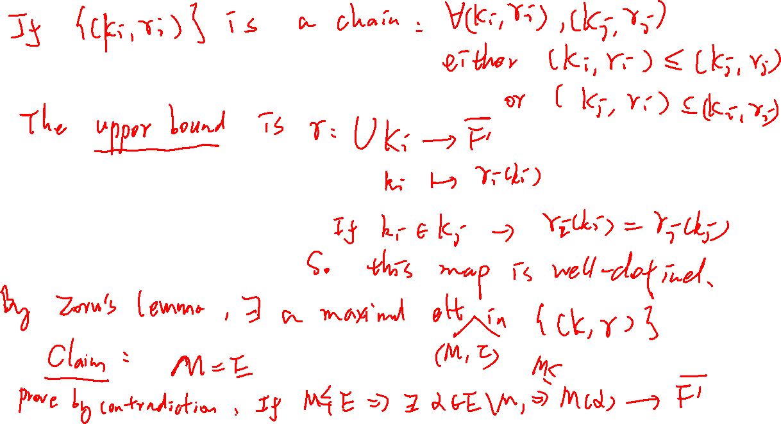

Slide 4
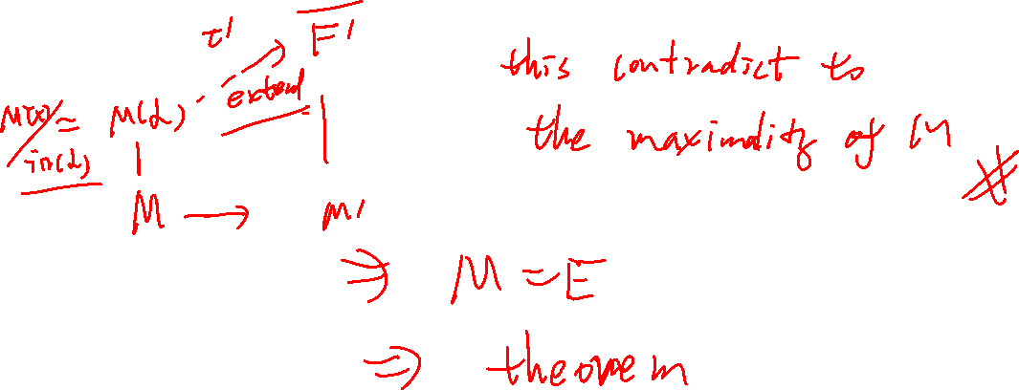

Slide 5

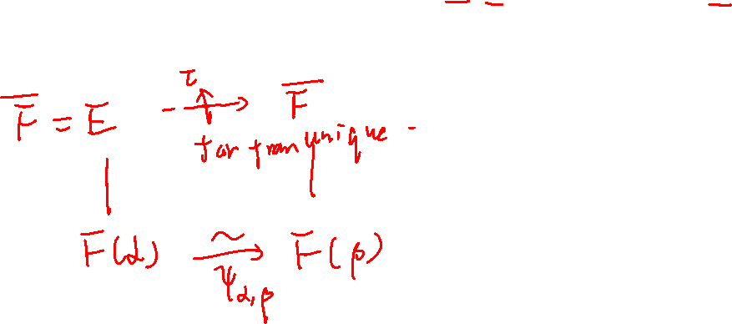

Slide 6

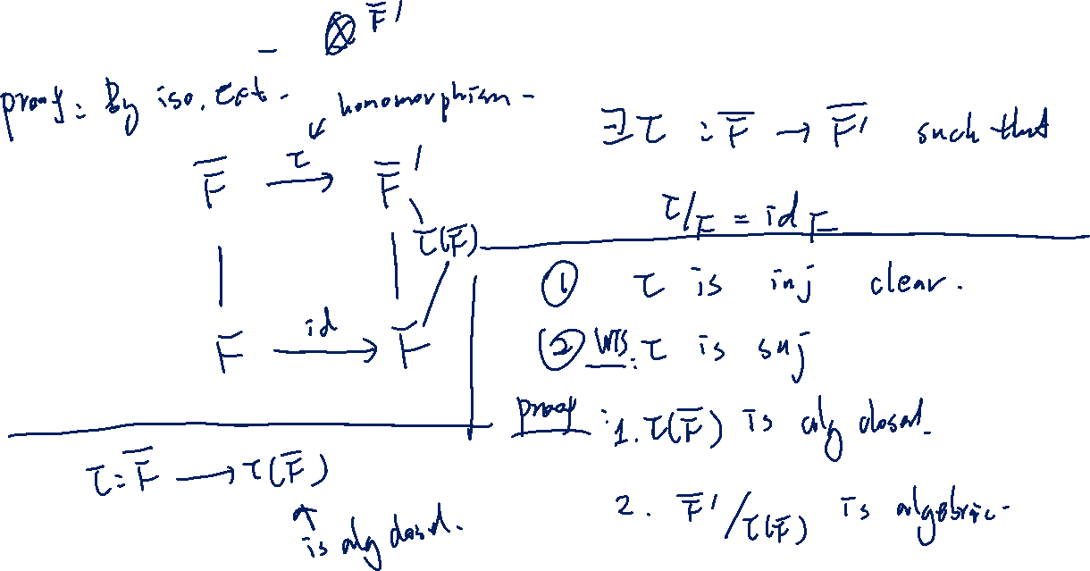

Slide 7
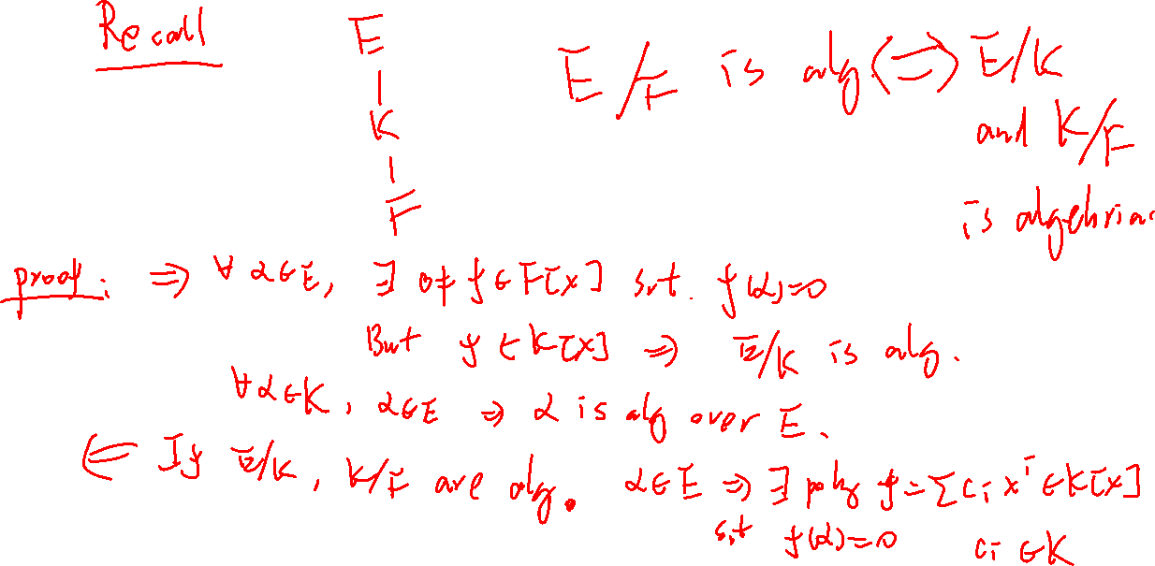

Slide 8
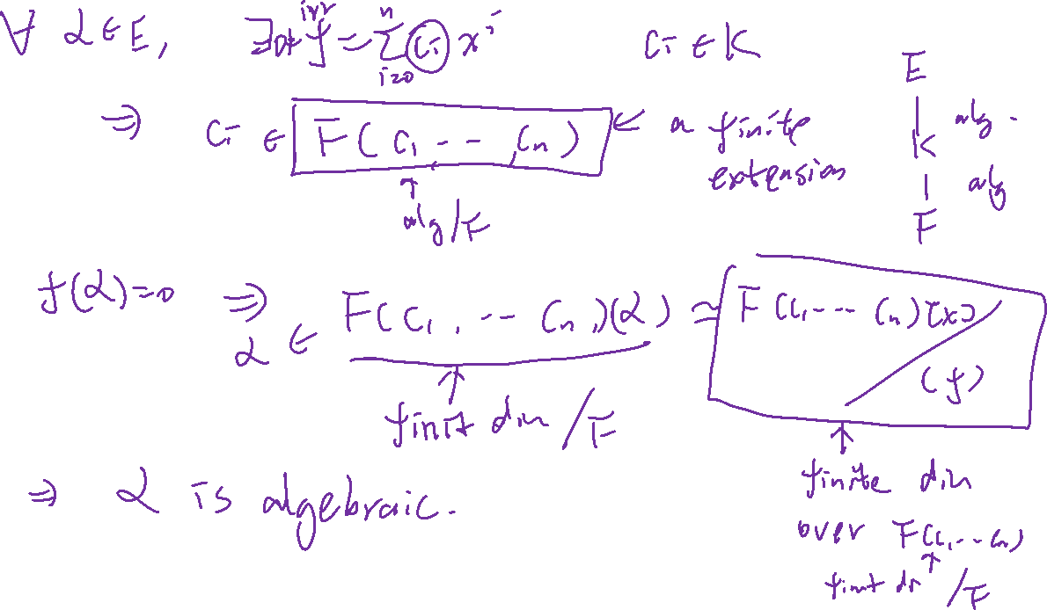

Slide 9


Remark:
1. Suppose $\overline{F}$ and $\overline{F}′$ are two algebraic closures of $F$.
Then every field homomorphism $τ:\overline{F}→\overline{F}′$ is a isomorphism

Slide 10
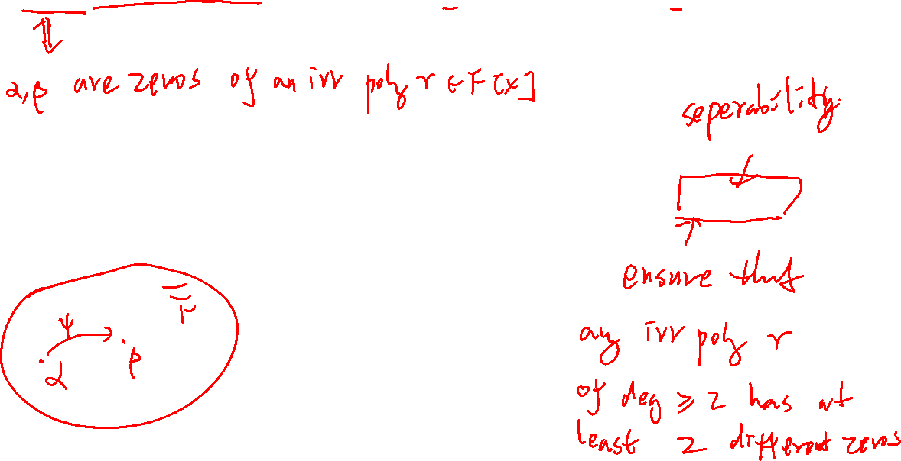
2. If $α, β$ are conjugate elements in $\overline{F}$. There is $τ∈G({\overline{F}}/F)$ such that $τ\left(α\right)=β$.
Corollary: For $α∈\overline{F}∖F$, there is a $ψ∈G(\overline{F}\backslash F)$ such that $ψ\left(α\right)≠α$ if $char F=0$.

Slide 11
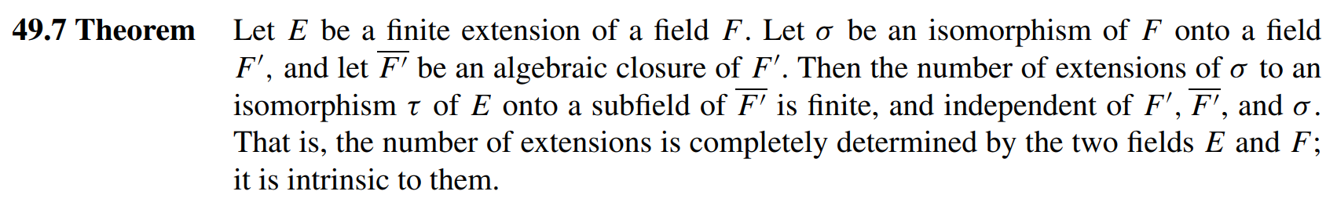
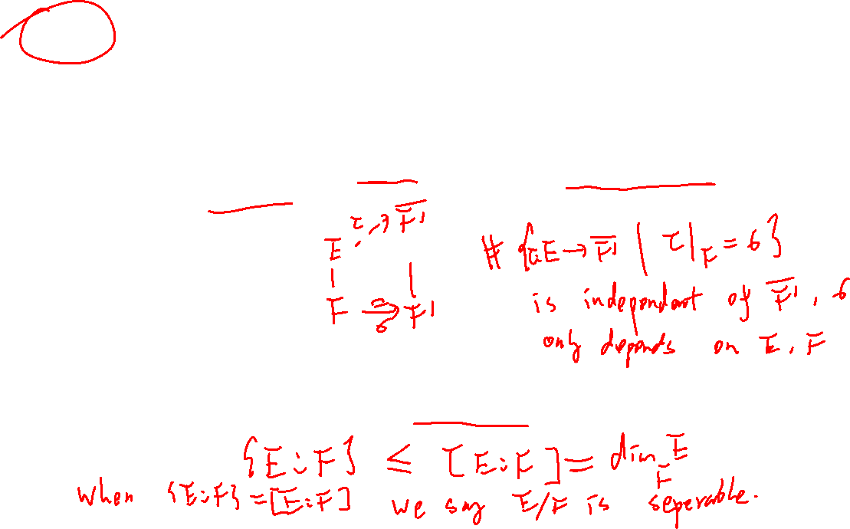
Index of a finite extension:

Slide 12

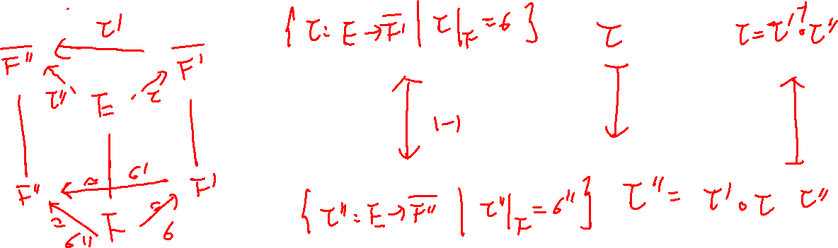




Proof:

Slide 13
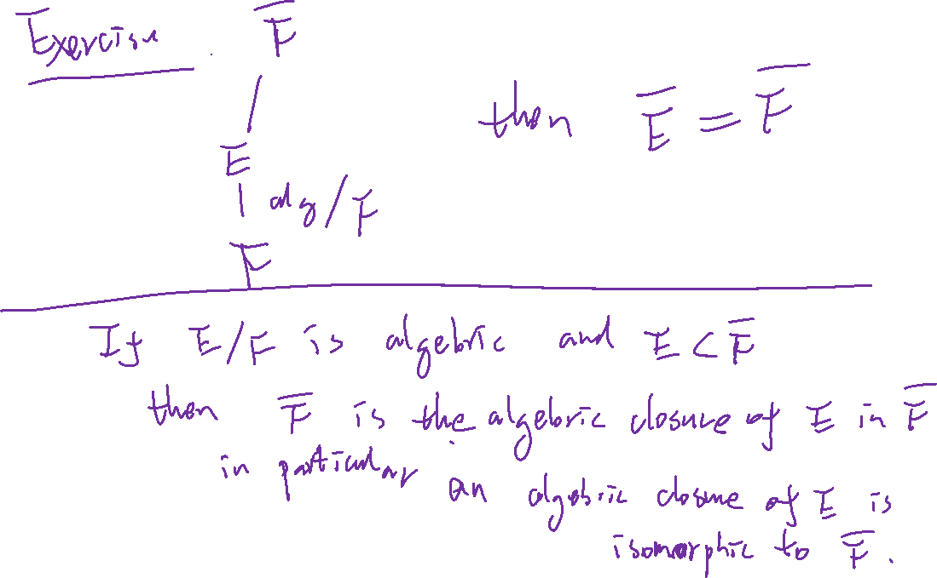

Slide 14
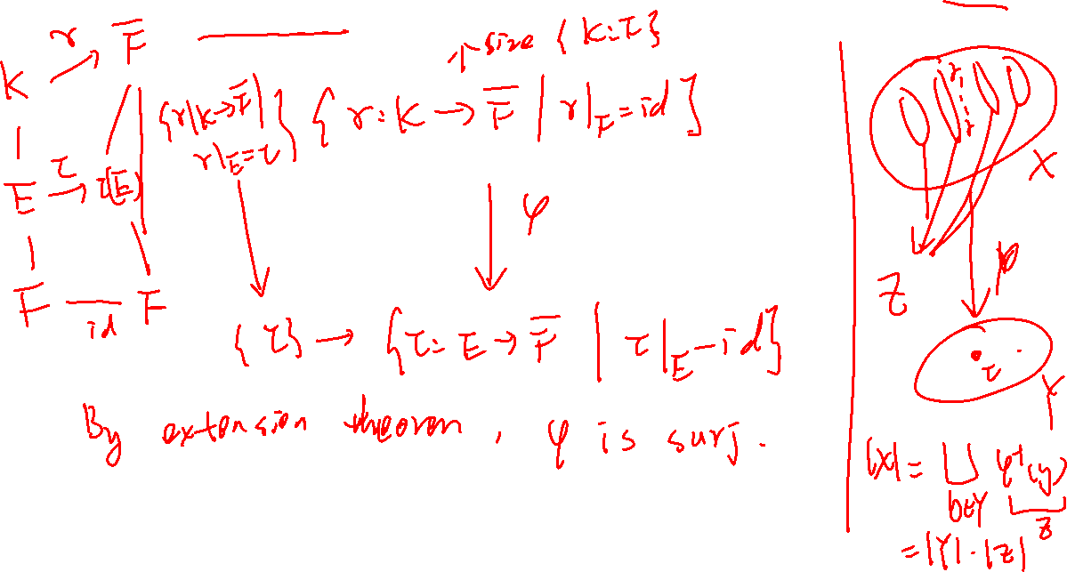

Slide 15
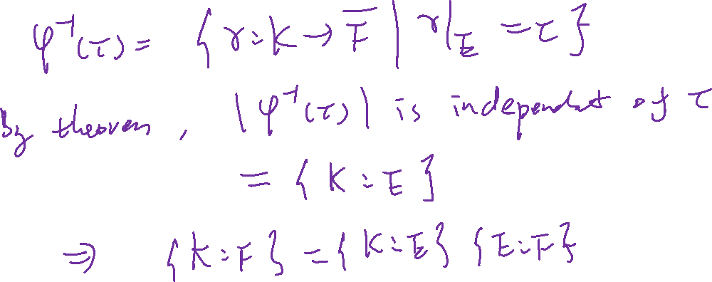

Slide 16
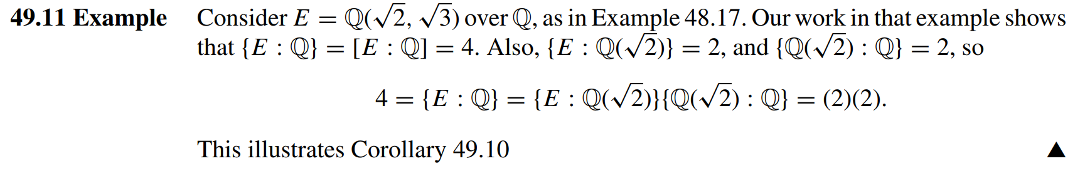
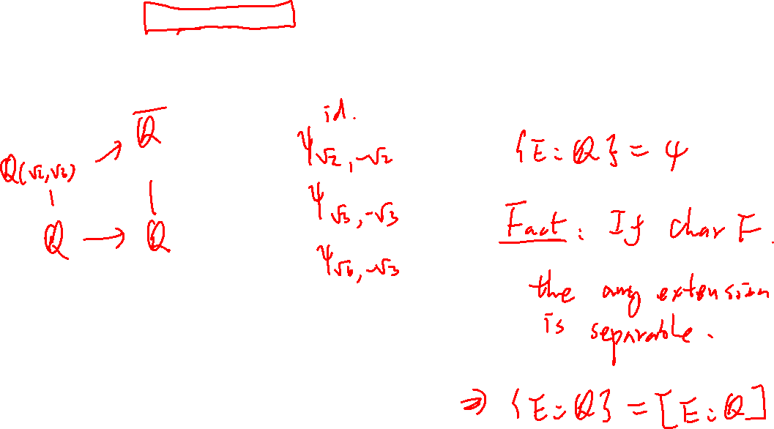

Slide 17
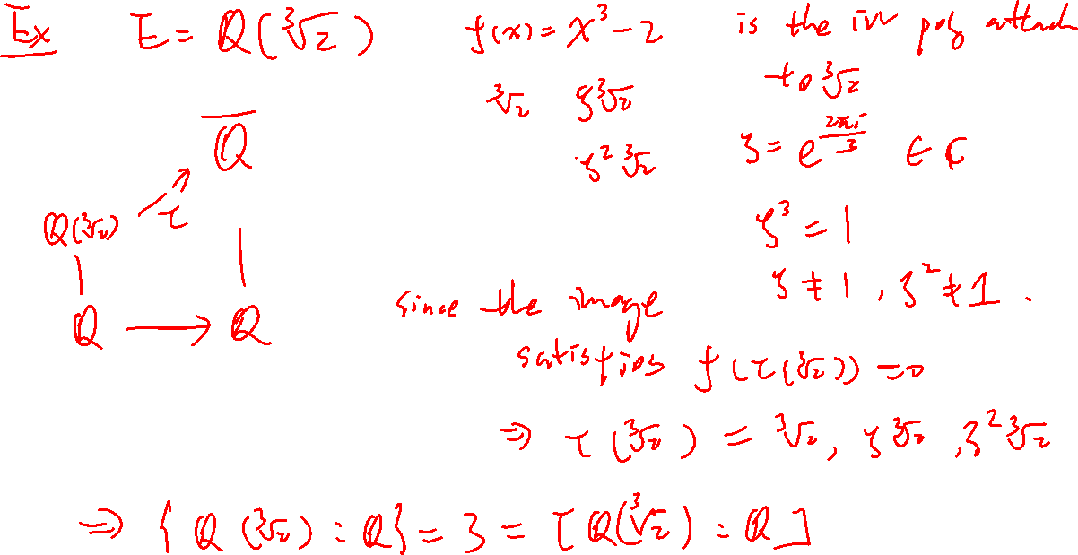

Slide 18
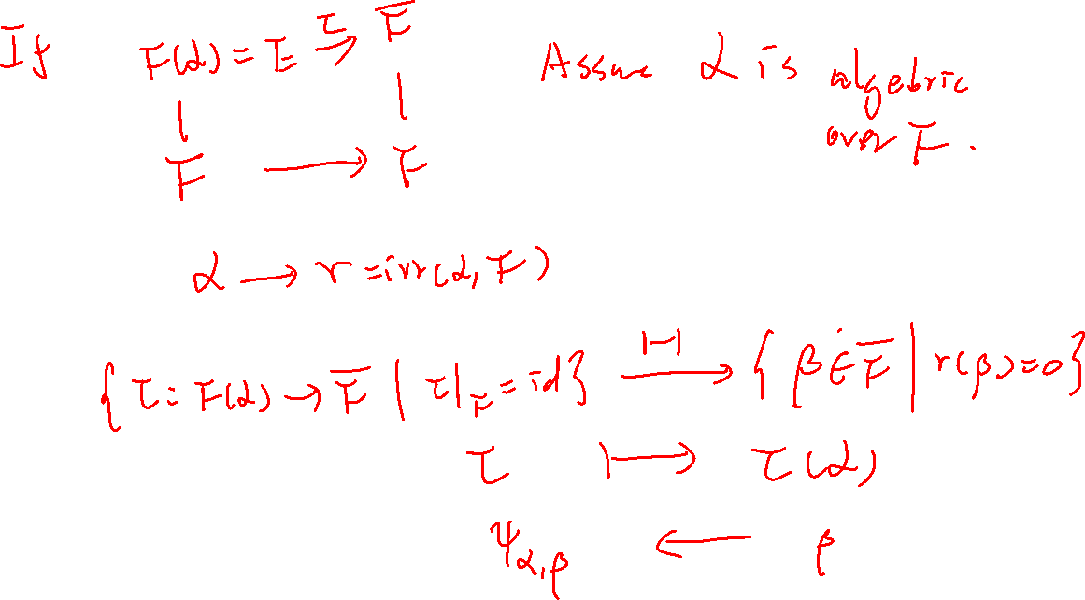

Slide 19

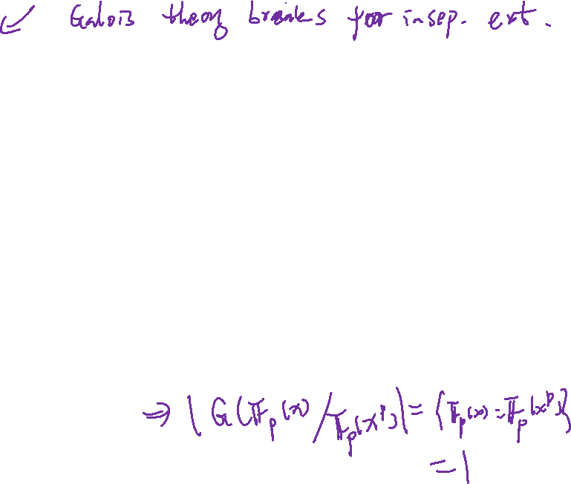
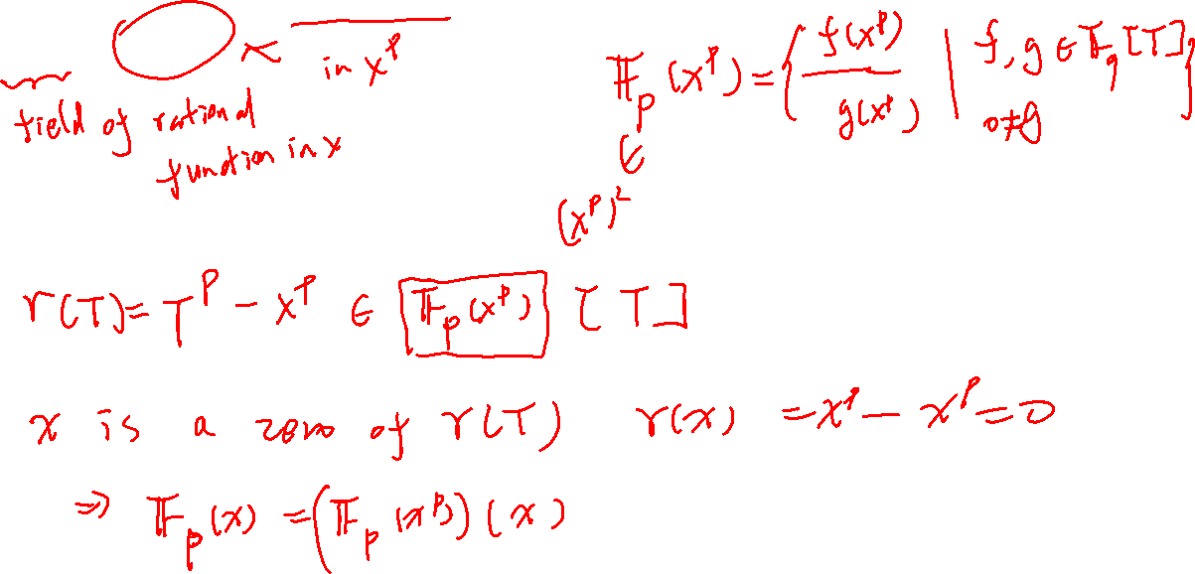
An Example of purely inseparable Extension: $𝔽_{p}\left(x\right)>𝔽_{p}(x^{p})$

Slide 20
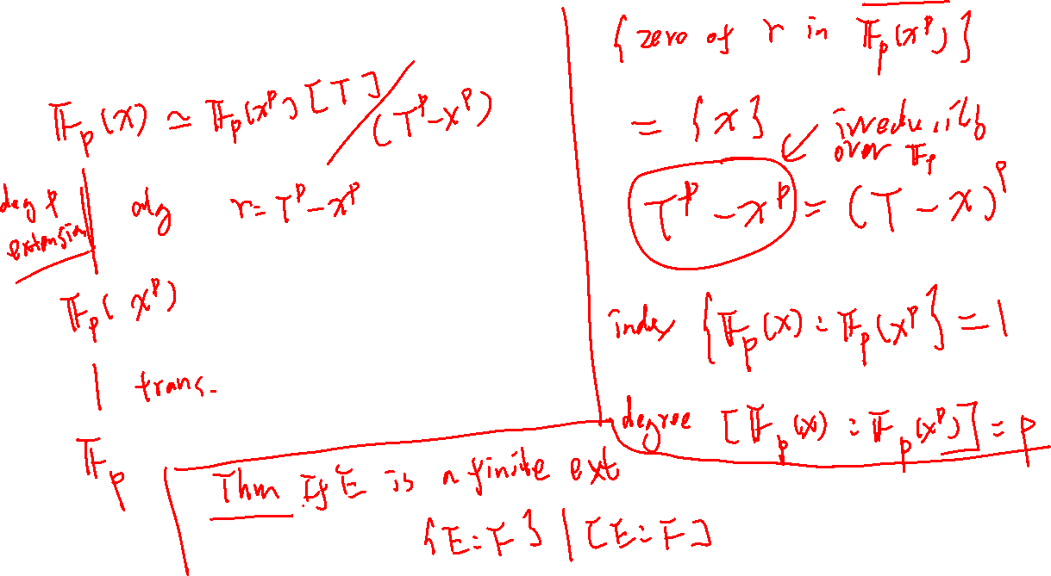

Slide 21

Splitting Field

Slide 22


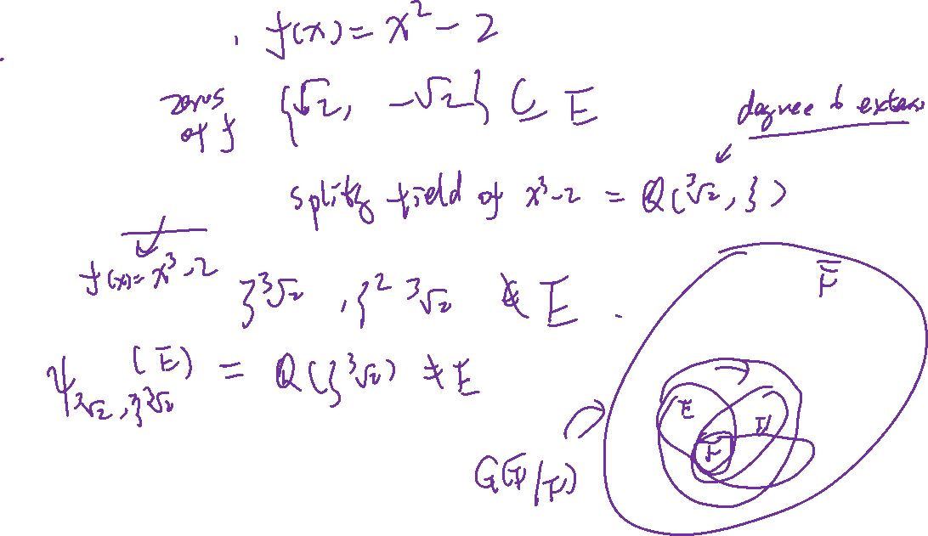
Example: $E=ℚ(\sqrt{2})$
Non-Example: $E=ℚ(\sqrt[3]{2})$

Slide 23
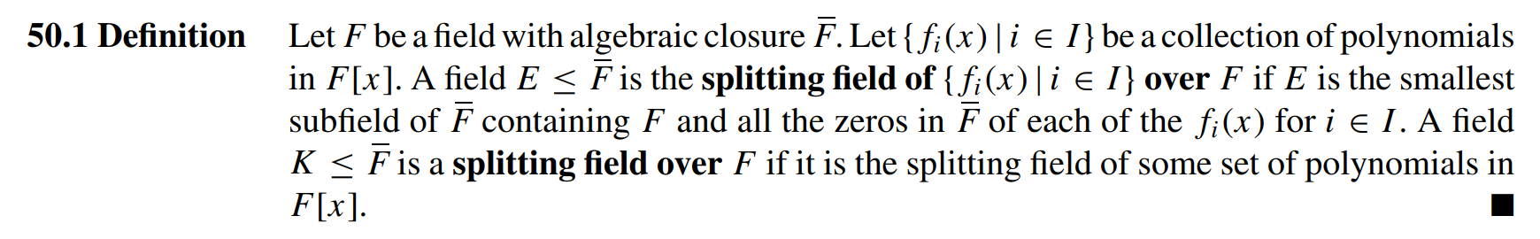

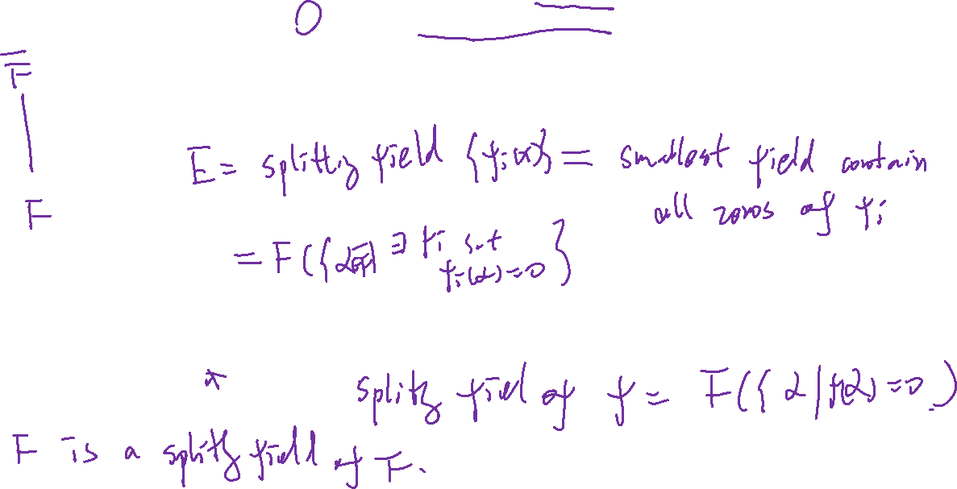

Slide 24
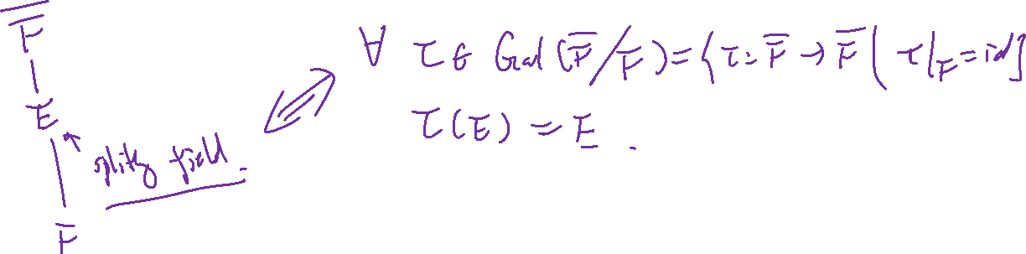

Slide 26
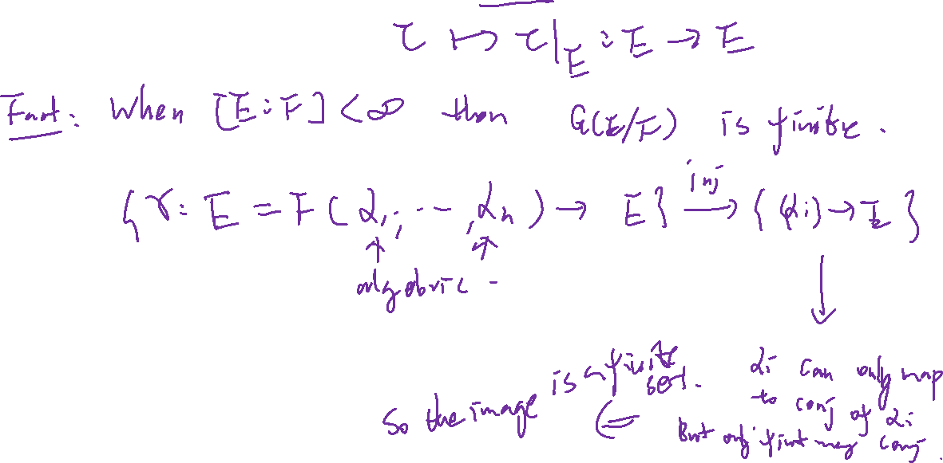
Implication: If $E$ is a splitting field, the following restriction map is well defined.
$$G\left({\overline{F}}/F\right)→G(E/F)$$

Slide 27
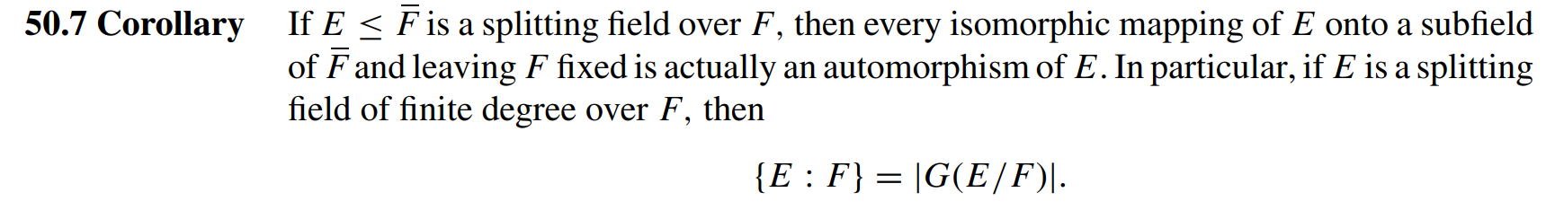
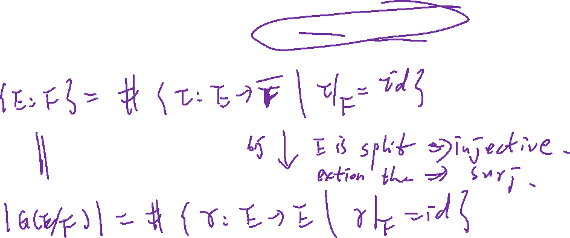

Slide 28
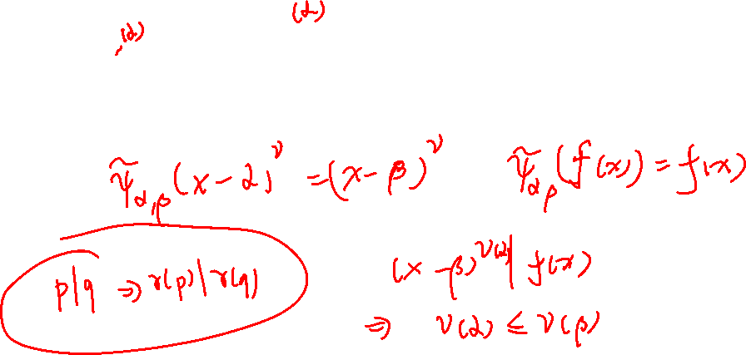
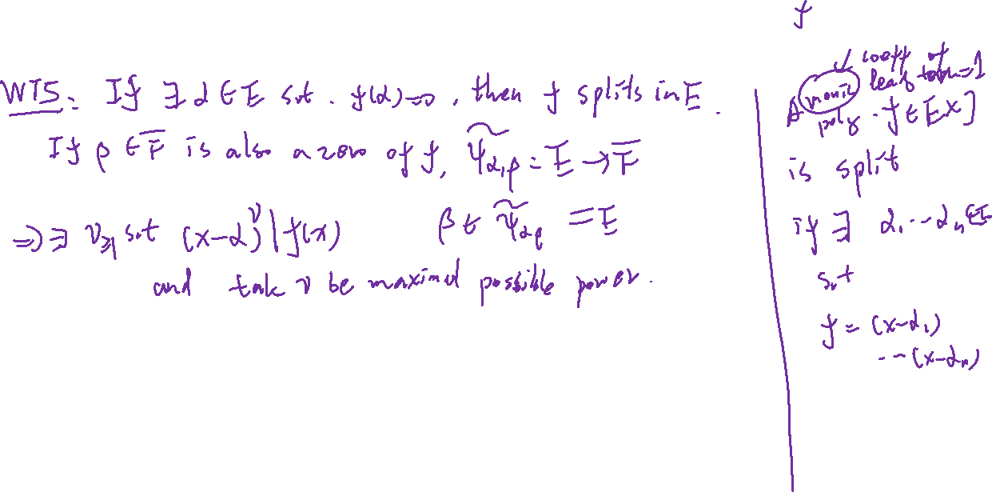

Slide 29
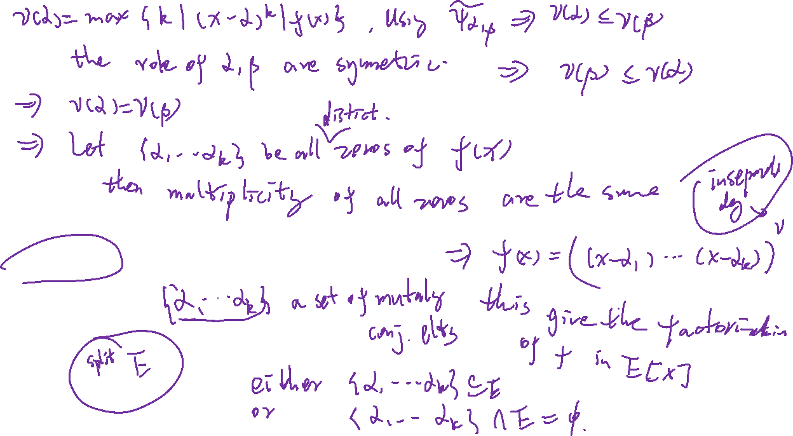
Dichotomy of zeros for a splitting field

Slide 30
